Slide 1
IFTW WCS issue report flow
IFTW PSS SMD GC TM SPB WCS
Traven

Slide 2
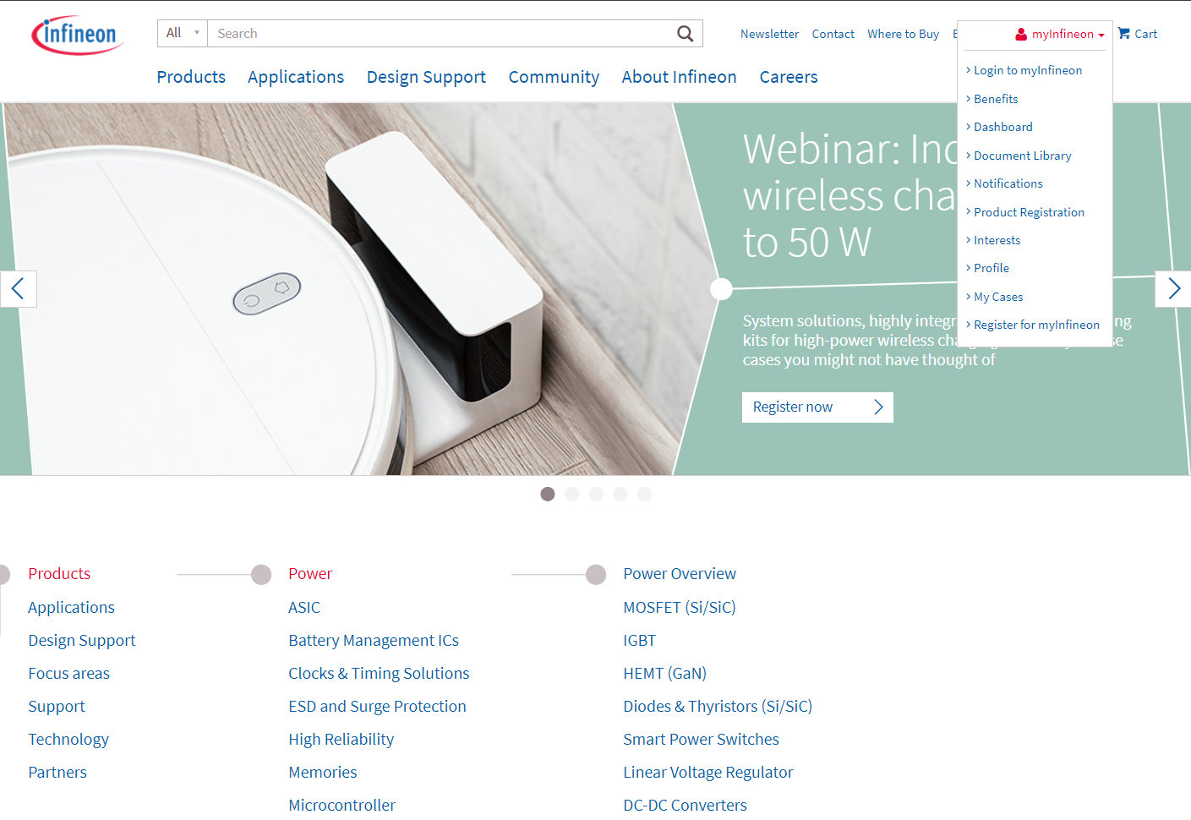
Microsoft Dynamic365

Slide 3
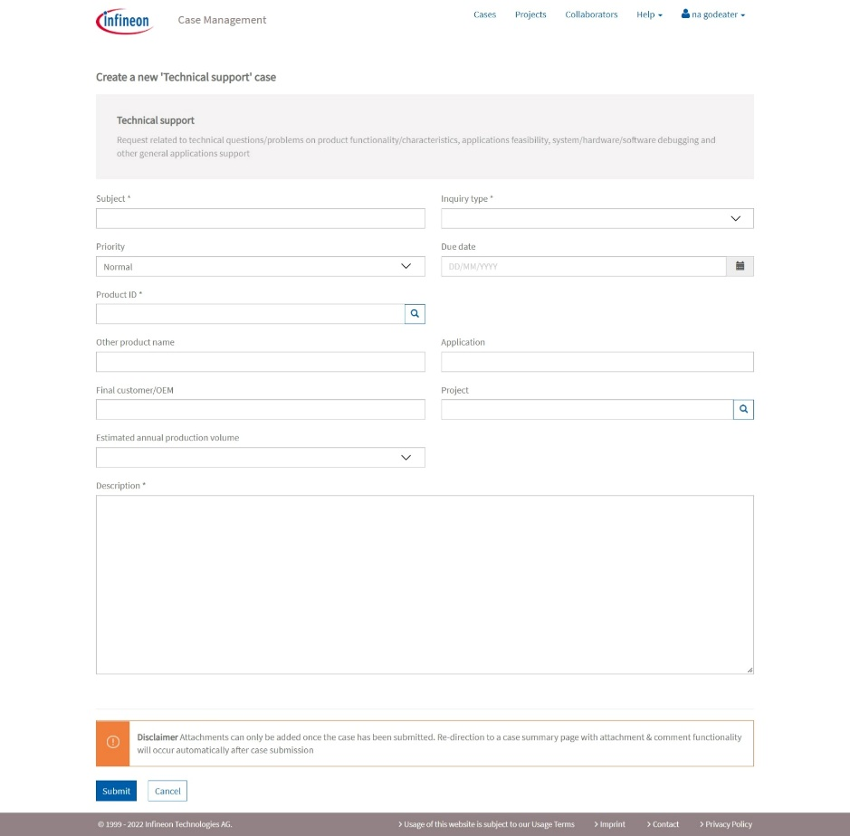

Case creation – Subject
[-oem-][-odm-][-project-][-ticket#-] short description
100 words as maximum
e.g.
[HP][IEC][Hook2][OBS1234567] power button event lost
[HP][TPV][Deora] PV1 power consumption too high

Slide 4
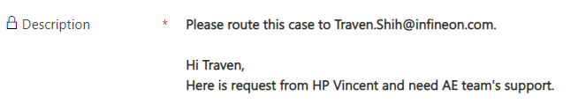
Case creation – Description
Include these information and designate to Infineon FAE (email)
Firmware / hardware version
Expected behaviour
Failure symptom
Failure rate
Reproduce steps
Function recovery method
Other necessary information

Slide 5
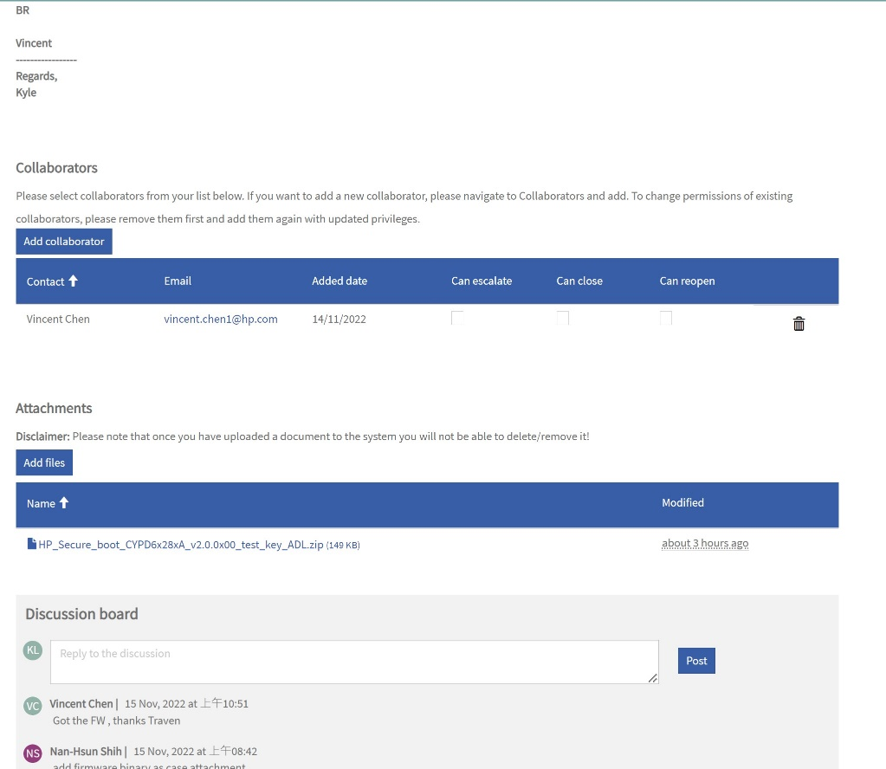
Case creation – Collaboration
Customers can add collaborator themselves in the Portal for their colleagues or other non-Infineon people. If they need to add Infineon colleagues, they need to request via discussion board.

Slide 6
Case creation – Discussion board
The interaction section where there is exchange of information/comments between CRM users (Case owners, Collaborators) and portal users (Case creators). It provides options to add internal and external comments on the case.

Slide 7
Case creation – Attachment
Basic
Issue Tracker Form (Mandatory)
CC logs in CYPD4500 PD3.0 / PD2.0
SALEAE logs
Ellisys C-Tracker logs
Others (test reports, screenshots or anything helpful to issues)
Recommended
CC with SALEAE Pro at 1.2V digital (IFTW Logger)

Slide 8
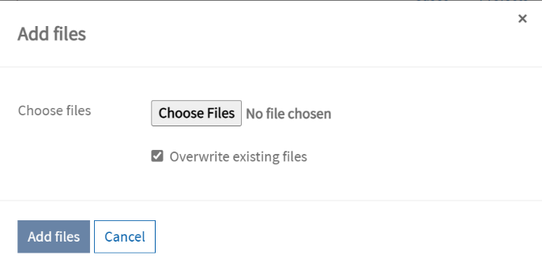
Case creation – Attachment format and file size
Upload limitation: 50MB
DO NOT overwrite if possible
Now allowed: ade;adp;app;asa;ashx;asmx;asp;bas;bat;cdx;cer;chm;class;cmd;com;config;cpl;crt;csh;dll;exe;fxp;hlp;hta;htr;htw;ida;idc;idq;inf;ins;isp;its;jar;js;jse;ksh;lnk;mad;maf;mag;mam;maq;mar;mas;mat;mau;mav;maw;mda;mdb;mde;mdt;mdw;mdz;msc;msh;msh1;msh1xml;msh2;msh2xml;mshxml;msi;msp;mst;ops;pcd;pif;prf;prg;printer;pst;reg;rem;scf;scr;sct;shb;shs;shtm;shtml;soap;stm;tmp;url;vb;vbe;vbs;vsmacros;vss;vst;vsw;ws;wsc;wsf;wsh.

Slide 9
IFTW WCS Logger – helper for log collection

Slide 10
SOP for log collecting – The WCS PD Host E2 training
 | INTEL Platform | AMD Platform | EVK Board | Checking Points
HW Signal | PCH_INT0# PCH_INT1# (Maple Ridge only) PCH_SDA PCH_SCL BBR_PWR BBR_RST SBU1/2 | APU_RST# APU_INT APU_SDA APU_SCL Retimer_SDA Retimer_SCL HPD SBU1/2 | MUX_SDA MUX_SCL HPD SBU1/2 | Is the I/O behavior normal !? Is the SBU signal normal !?
CC Log | CC Log | CC Log | CC Log | Is enter DP Alt mode? Is device issue the Attention HPD High message to Host?
I2C Log | PCH I2C Log Retimer I2C Log | APU I2C Log Retimer I2C Log | MUX I2C Log | Compare the PASS log and Fail log to dig out is anything abnormal.

Slide 11
Issue report flow SOP
Start
IFX issues?
No
Issue transfer
Yes
Fill up
issue tracker form
Collect pass and
fail cases logs
Submit an MSD case
No
MSD case exist?
Yes
Trial solutions released through MSD case
Issue resolved?
No
Yes
Confirmations from
ODM/OEM
Official release through MSD case
Case closed

Slide 12
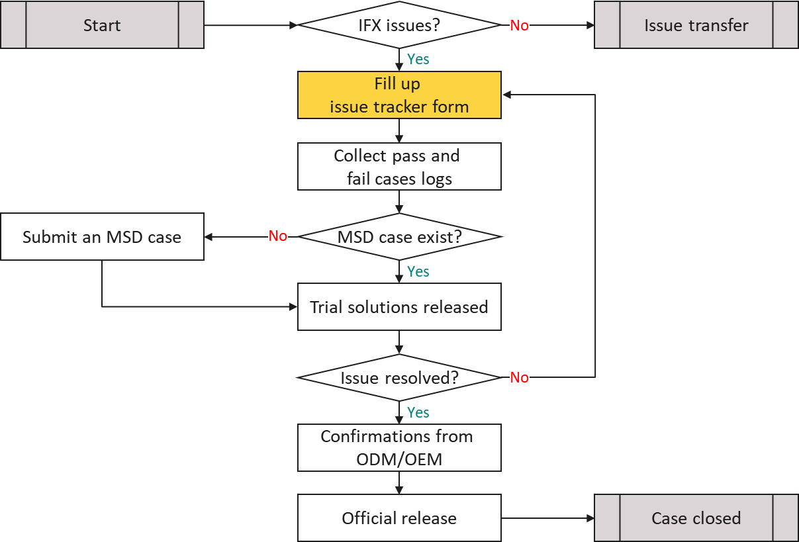
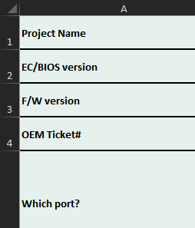
Issue report flow SOP – Infineon Issue Tracker Form
Specialised for WCS PC host applications
Issue information

Slide 13
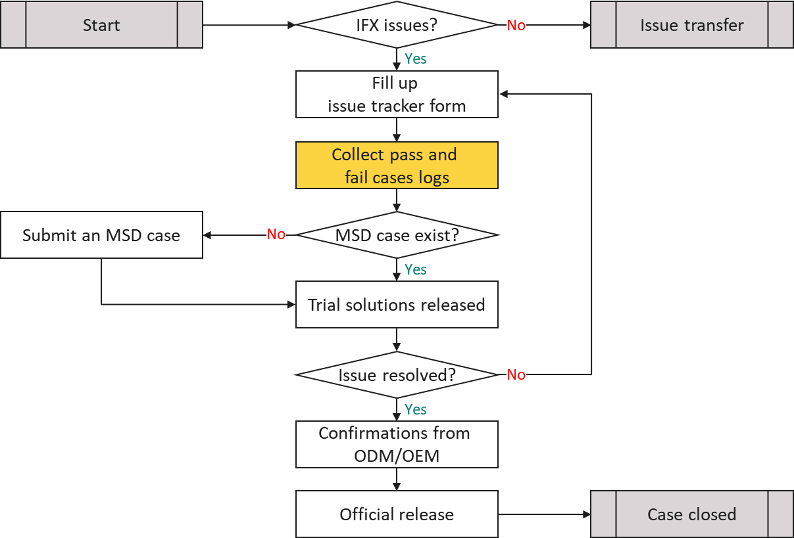
Issue report flow SOP – Infineon WCS Logger
WCS Logger
Tracker Form
CYPD4500 PD3.0
SALEAE logs
Ellisys C-Tracker logs

Slide 14
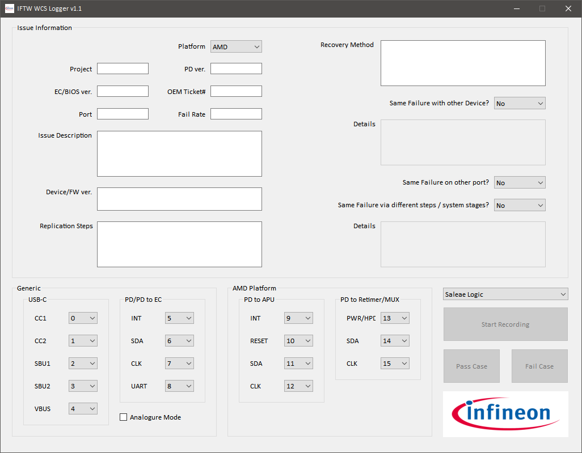
Infineon WCS Logger
Issue Information
Generic
USB-C
PD/PD to EC
Analogue Mode
AMD/INTEL Platform
PD to APU/Ridge
PD to MUX/Retimer
Saleae Logic/Ellisys C-Tracker
Start Recording
Pass Case
Fail Case

Slide 15
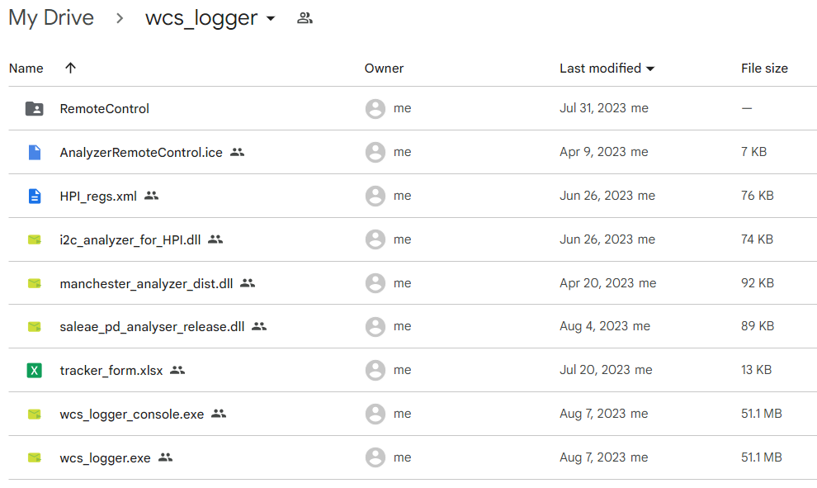
Infineon WCS Logger – Prerequisites
Toolkit:
A CY4500.
A SALEAE 16ch Pro Logic Analyser.
An Ellisys C-Tracker (optional).
Software:
EZ-PD Protocol Analyzer Utility v3.1.x.
SALEAE Logic2 v2.4.0+.
“Saleae_PDCC_Release” CC analyser plugin.
“I2C_HPI” I²C analyser plugin.
Ellisys Type-C Tracker Analyzer.
Download: https://drive.google.com/drive/folders/1AqxentVzGbndPK5DALp_iF4E_E6OO_a0?usp=sharing

Slide 16
Infineon WCS Logger – Function Flow
Launch Logger
Fill up all data
Connect pins accordingly
Hit
“Start Recording”
Do issue
replication steps
Yes
See issues?
No
Save as Fail Case?
No
Hit
“Abort Recording”
No
Save as Pass Case?
Yes
Yes
Hit
“Fail Case”
Hit
“Pass Case”
Finish?
Yes
Exit Logger
No

Slide 17
Issue report flow SOP – Faster and Easier
Conventional log capture flow
Open issue tracker form
Fill up all fields except “waveforms”, 14 fields in total
Run/Select EZ-PD Protocol Analyzer Utility
Click “Start”
Run/Select Saleae Logic2
Setup channels, names, mode, bitrate
Click “Start”
Reproduce issues
In EZ-PD Protocol Analyzer Utility
Click “Stop”
Click “Save”
Type file name and save
Click “OK” to close the confirmation dialog
In Saleae Logic2
Click “Stop”
Assign I2C, UART and CC analysers to channels
Type file name and save
Fill up “waveforms” field in issue tracker forms with all log filenames created above.
Go to step4 for another log capture round
In Infineon automation tool flow
Run WCS Logger
Fill up all blank fields, 10 – 12 in total
Click “Start Recording”
Reproduce issues
Click “Pass case” or “Fail case”
Go to step3 for another log capture round

Slide 18
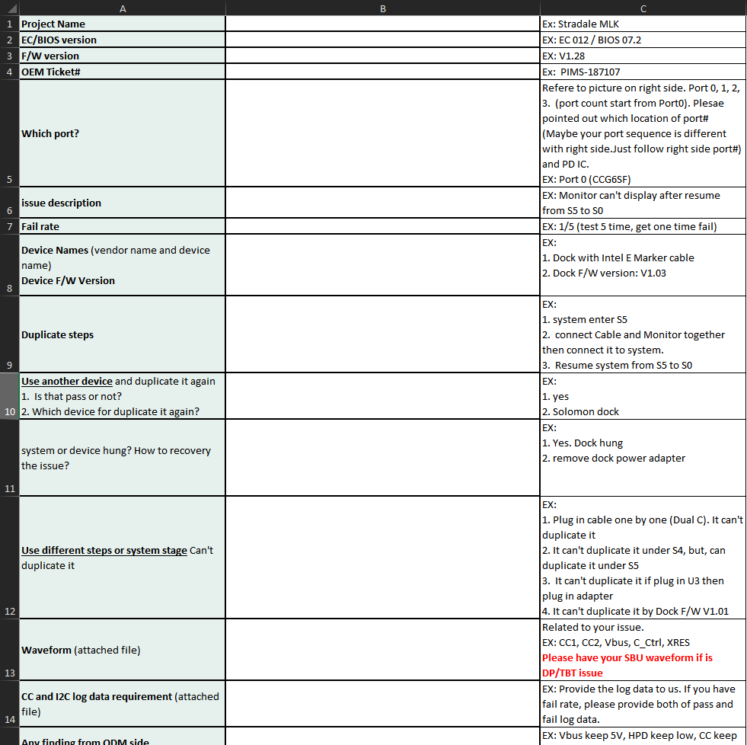
SOP for log collecting – Infineon Issue Tracker Form
Specialised for WCS PC host applications
Issue information

Slide 19
Infineon WCS Logger – SALEAE use case (1/2)
Start Logger.
Fill all information and platform type in Issue Information and mapping SALEAE pins with pre-defined channels or preferred ones.
All fields are mandatory except “OEM Ticket#”.
“Start Recording” button will grey out if any blank field or channel duplicated.
Click “Start Recording” to start log collecting per setup.
Click “Abort Recording”, “Pass Case” or “Fail Case” while test finished.
Logger will assign relevant analysers to SALEAE logs and create a folder using current time format contains:
Issue tracker form.
SALEAE log files.
CY4500 log files.
Setup log: e.g. 20230522.txt

Slide 20
Infineon WCS Logger – SALEAE use case (2/2)
Scenario A: SALEAE Logic2 is not running while starting Logger:
Will launch SALEAE Logic2 application with automation supportive automatically.
Keep SALEAE Logic2 application running while log captures are finished.
Will shutdown SALEAE Logic2 application while Logger is closed.
Scenario B: SALEAE Logic is running while starting Logger:
Will use the running SALEAE Logic2 application, which needs to enable automation server before hand.
Keep SALEAE Logic2 application running while log captures are finished.
Will ***NOT*** shutdown SALEAE Logic2 application while Logger is closed.
Click “Start Recording” again for another capture cycle.
Close Logger while finish test.

Slide 21
Logs submission
Zip all files and submit to case

Slide 22
Infineon WCS Logger – Limitations
Logger might crash if SALEAE Logic2 application doesn't enable "Automation Server" at Scenario B.
Doesn't support SALEAE Logic Analyser 8ch SKU.
DO NOT control log applications directly.
Logger cannot rename channel names in SALEAE logs.

Slide 23
We will …
Release firmware / documents on case system instead of emails.
Turn down cases if insufficient information is provided.
Issue tracker form
CYPD4500 CC logs
SALEAE logs
Ellisys C-Tracker logs
Others (optional)

Slide 24

Questions?
traven.shih@infineon.com
LINE
ifx-traven

